Slide 1
CSC 539: Operating Systems Structure and Design
Spring 2005
Influential operating systems
  Atlas, CTSS, MULTICS, IBM OS/360, UNIX, Alto, Mach
Case studies
  Linux
  Windows XP
Course overview

Slide 2
Influential operating systems
Atlas (1961), University of Manchester
  batch system with spooling (uses disk as buffer for reading ahead or storing output)
  introduced many OS features: device drivers, demand paging, reference bit
CTSS (1962), MIT
  first practical timesharing system, supported up to 32 users at terminals
  CPU scheduling involved priorities, multilevel feedback queue to age programs
  swapped entire program out to fast drum
MULTICS (1965), MIT (+ GE + Bell Labs)
  designed as a general-purpose extension to CTSS (~300,000 lines of code)
  utilized paged segments, multilevel feedback queue
  hierarchical directory structure, protection via access lists
  not fully functional until 1969
OS/360 (1966), IBM
  designed as a common OS for all IBM computers
  reduced development & maintenance costs, allowed migration of users & programs
  suffered from bloated code, too many complex & interleaved features

Slide 3
Influential operating systems
OS/360 (1966), IBM
  designed as a common OS for all IBM computers
  reduced development & maintenance costs, allowed migration of users & programs
  since
UNIX (1972), Bell Labs
  first portable OS, written entirely in C (developed by Thompson & Ritchie)
  open source for academic use, led to BSD UNIX & other variants
Alto (1978), Xerox PARC
  introduced modern GUI interface, WIMP
  viewed by Jobs, co-opted for Apple Mac OS (and eventually Windows)
Mach (1986), CMU
  built upon the BSD UNIX kernel
  goals: emulate BSD, support memory models & parallel/distributed, microkernel
  provided support for multiprocessing, threads
  versions of Mach underlie the NeXT OS, Mac OS X

Slide 4
Linux history
Linux is a modern, free operating system based on UNIX standards
  first developed as a small but self-contained kernel in 1991 by Linus Torvalds, with the major design goal of UNIX compatibility.
  its history has been one of collaboration by many users from all around the world, corresponding almost exclusively over the Internet
  it has been designed to run efficiently and reliably on common PC hardware, but also runs on a variety of other platforms (68000-series, Sun SPARC, PowerMac, …)
Linux kernel is original, but full system incorporates existing UNIX software
  uses many tools developed as part of Berkeley’s BSD operating system, MIT’s X Window System, and the Free Software Foundation's GNU project
  Linux kernel is distributed under the GNU General Public License (GPL): free to modify code but cannot make proprietary; also must distribute source code
  many companies (e.g., SUSE, Slackware, Red Hat, Debian/GNU) market Linux distributions: precompiled Linux packages with installation and management utilities

Slide 5
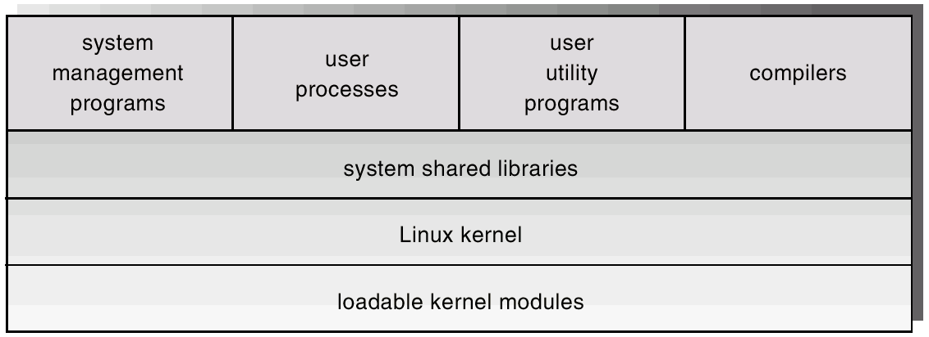
Linux design principles
Linux is a multiuser, multitasking system with UNIX-compatible tools
  its file system adheres to traditional UNIX semantics, and it fully implements the standard UNIX networking model
  main design goals are speed, efficiency, and standardization
  Linux is designed to be compliant with the relevant POSIX documents
like most UNIX implementations, Linux is composed of 3 main bodies of code:
system utilities perform individual specialized management tasks
system libraries define standard set of functions through which apps interact with the kernel
kernel is responsible for maintaining the important abstractions of the OS
  executes in unrestricted kernel mode
  all kernel code & data in one address space

Slide 6
Process management
UNIX process management separates the creation/execution of processes
  fork system call creates a new process, inherits environment from parent
  a new program is run after a call to execve
  a thread is a process that happens to share the same address spaces as its parent (uses clone system call instead of execve)
a request for kernel-mode execution can occur in 2 ways
  program can request OS service (e.g., system call, page fault)
  device driver may deliver hardware interrupt that triggers interrupt handler
  starting with Linux 2.6, kernel is fully preemptible
  provides spinlocks and semaphores for synchronization
utilizes 2 different process scheduling algorithms
  time-sharing algorithm for preemptive scheduling between multiple processes
    priority based, gives high priority jobs longer time quanta, dynamic priorities
  real-time algorithm for tasks where priorities are more important than fairness
    within priority classes, can use FIFO or round-robin

Slide 7
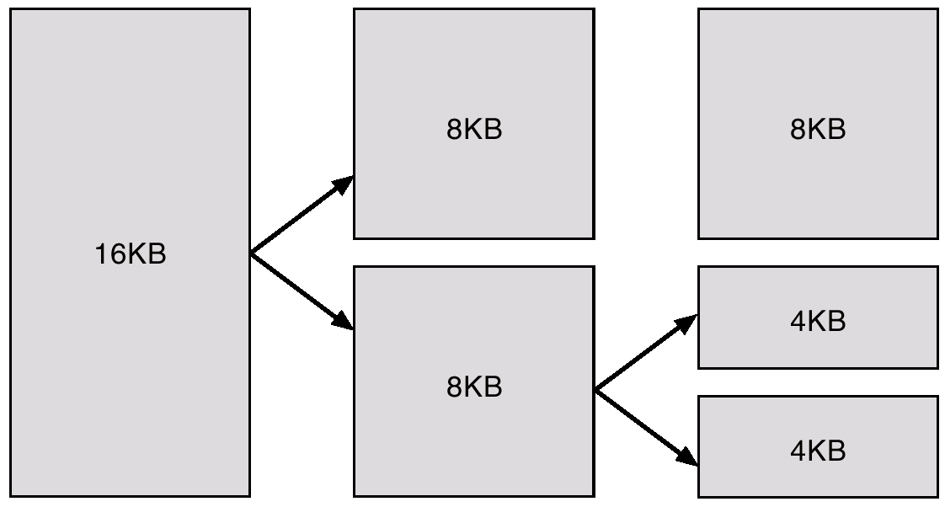
Memory management
Linux’s physical memory-management system deals with allocating and freeing pages, groups of pages, and small blocks of memory
  has additional mechanisms for handling virtual memory, memory mapped into the address space of running processes
page allocator allocates & frees all physical pages
  uses buddy-heap algorithm to keep track of physical pages
  each allocatable memory region is paired with an adjacent partner
  whenever buddies are both freed, are combined
  large region may be divided for smaller requests
memory allocations in the kernel occur either statically (drivers reserve contiguous space during system boot) or dynamically (via page allocator)

Slide 8
Virtual memory
the VM system maintains the address space visible to each process
  creates pages of virtual memory on demand, and manages the loading of those pages from disk or their swapping back out to disk as required
the VM manager maintains 2 separate views of a process’s address space:
  a logical view describing instructions concerning the layout of the address space (address space consists of a set of nonoverlapping regions, each representing a continuous, page-aligned subset of the address space)
  a physical view of each address space which is stored in hardware page tables
page replacement algorithm is modified version of second-chance
  each page has age associated with it, measures amount of recent activity
  in effect, implements Least Frequently Used (LFU) approximation of LRU

Slide 9
File & I/O management
to the user, Linux’s file system appears as a hierarchical directory tree
  internally, the kernel hides implementation details and manages the multiple different file systems via an abstraction layer -- the virtual file system (VFS).
  the Linux VFS is designed around object-oriented principles and is composed of two components:
    a set of definitions that define what a file object is allowed to look like (inode-object and file-object structures represent individual files)
    a layer of software to manipulate those objects
Linux device drivers appear as objects within the file system
  block devices allow random access to independent, fixed size blocks of data
  character devices include most other devices; don’t need to support the functionality of regular files.
  network devices are interfaced via the kernel’s networking subsystem

Slide 10
Windows XP history & goals
Microsoft Windows XP is a 32/64-bit preemptive multitasking OS
  successor of Windows NT/2000, replaces Windows 95/98
  released in October 2001, server version in 2002
  introduced "better" visual design, simpler menus, easier HCI
  multiuser support through multiple instances of GUI via Windows terminal server
design goals
  security: strict adherence to design standards, extensive code review & testing
    utilizes sophisticated automatic analysis tools to identify security vulnerabilities
  reliability: most reliable, stable version of Windows
    extensive manual and automatic code review, driver verification & error-checking
  compatibility: introduces compatibility layer to ensure execution of older software
    also provides POSIX support, so can compile and run most UNIX software
  performance: uses a variety of techniques to build on performance of 2000/NT
  extensibility: uses a layered architecture to allow for changes/updates
  portability: mostly written in C/C++
    CPU-dependent code isolated in hardware-abstraction layer (HAL)
  international support: uses UNICODE, provides support for local languages/formats

Slide 11
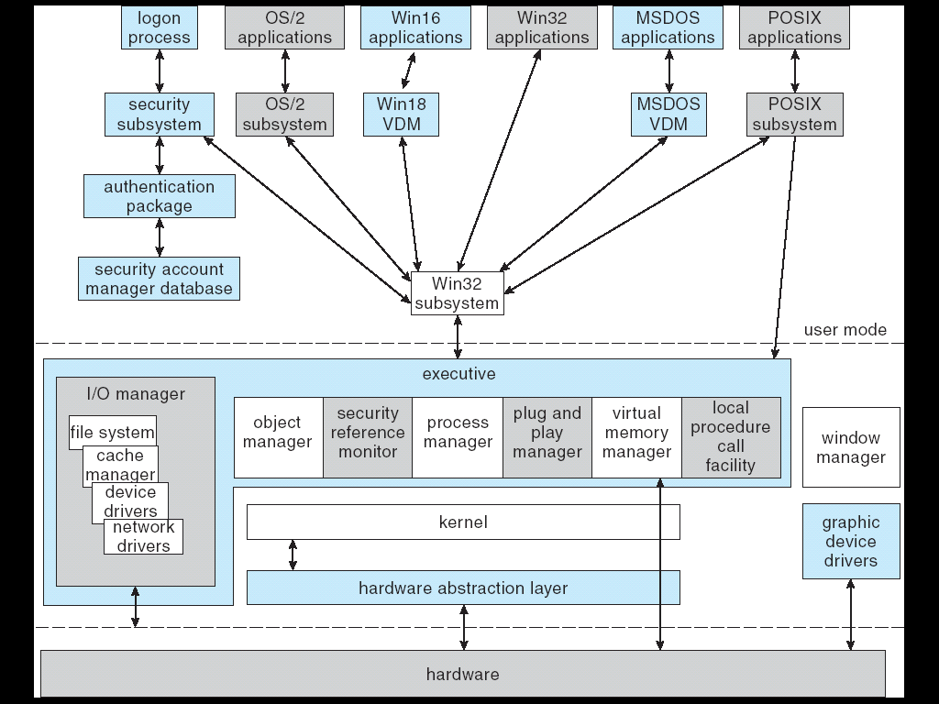
XP layered architecture
hardware abstraction layer (HAL) hides hardware differences from the OS
kernel provides the foundation for the executive and the subsystems
executive provides services, including process manager, VM manager, I/O manager
environmental subsystems are user-mode processes that enable XP to run processes developed for other OS's (Win32 is base)

Slide 12
Process management
a process is an executing instance of an application
a thread is a unit of code that can be scheduled by the OS
like NT/2000, XP uses a 32-level priority scheme to determine the order of thread execution
  real-time class contains threads with priorities ranging from 16 to 32
  variable class contains threads having priorities from 0 to 15
  kernel automatically adjusts priorities based on CPU utilization
    enables I/O-bound threads to keep the I/O devices busy
    CPU-bound threads soak up the spare CPU cycles in the background

Slide 13
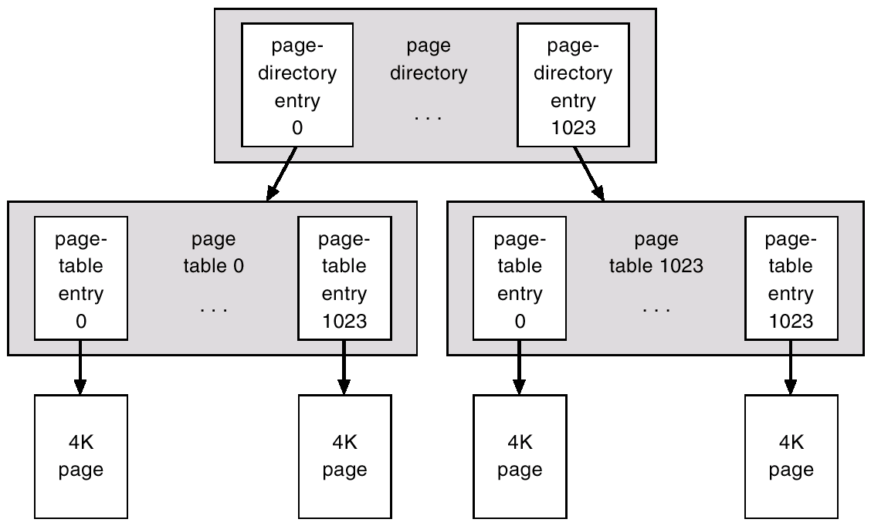
Memory management
the VM manager assumes that the underlying hardware supports:
  virtual to physical mapping a paging mechanism
  transparent cache coherence on multiprocessor systems, and
  virtual addressing aliasing
VM manager uses
  a page-based management scheme with
  a page size of 4 KB
  multilevel page table, utilizes TLB
  uses per-process FIFO replacement policy
  adjusts number of frames per process by monitoring working-set
  performs prefetching to try to swap in pages before needed
  for performance, allows privileged process to lock select pages in physical memory

Slide 14
File & I/O management
utilizes the NT File System (NTFS)
  provides many modern features: data recovery, fault tolerance, large files, UNICODE names, encryption, compression, …
  a file in NTFS is a structured object consisting of attributes (not a simple byte stream, as in MS-DOS or UNIX)
  a directory is stored in a B+ tree structure to provide consistent access time
  NT supports FAT16 to read floppies, FAT32 for Windows 95/98 media
I/O manager is responsible for file systems, cache management , device drivers, network drivers
  keeps track of which installable file systems are loaded, and manages buffers for I/O requests.
  works with VM Manager to provide memory-mapped file I/O.
  controls the 2000 cache manager, which handles caching for the entire I/O system.

Slide 15
FINAL EXAM
Tuesday, May 3 10:00 – 11:40
format similar to previous tests
  factual knowledge: TRUE/FALSE
  conceptual understanding: short answer, discussion
  synthesis and application: process scheduling, paging, C++ simulation, …
study advice
  review online lecture notes
  review text
  reference other sources for examples, different perspectives
  look over tests, homeworks, quizzes, online review sheet

